Slide 1
Basic statements
Programming Language Design and Implementation (4th Edition)
by T. Pratt and M. Zelkowitz
Prentice Hall, 2001
Section 8.3.1-8.3.2

Slide 2
Assignment
Basic attribute for imperative languages, although syntax differs:
A := B Pascal, Ada
A = B C, FORTRAN, PL/I, Prolog, ML, SNOBOL4
MOVE B TO A COBOL
A ← B APL
(SETQ A B) LISP
Note that LISP, an applicative language, has an assignment. Most LISP programmers do not write purely applicative programs.
C has multiple ways to assign: A=B, A++, ...
How many C assignment operations can you identify?

Slide 3
Explicit sequence controls
Early languages used labels on statements and explicitly determined location of branches (early FORTRAN):
IF (A.GT.7) GOTO 100
...
100 CONTINUE ⇐ Explicit control
This is the “goto” controversy of the early 1970s. Languages do not need explicit control and concept is not used or needed even if present.
C includes a break statement for exit out of a loop. It is a limited form of goto, that also has its problems with correctness.

Slide 4
Control structures
Basic control structures: Programs need 4 basic structures:
A sequencing between statements
A conditional for choosing alternatives
A Loop construct
A function call for calling subroutines. (We consider subprograms elsewhere in this course.)

Slide 5
Sequencing
Compound statement: Typical syntax:
begin
statement1;
statement2;
...
end;
Execute each statement in sequence.
Sometimes (e.g., C) { ... } used instead of
begin ... end

Slide 6
Conditional
The if statement is typical:
if expression then statement1 else statement2
if expression then statement1
The expression is evaluated and if true, the then clause is executed, otherwise the else clause is executed. If there is no else clause, then the next statement is executed.
Since a begin statement is a statement, the then or else clause can be an arbitrary number of commands.
As with everything else in C, its austere syntax for if is: if (expression) statement1 else statement2;

Slide 7
Iteration
Four iterations are most common:
while expression do statement; - Evaluate expression and if true execute statement. Then repeat process.
Repeat statement until expression; - Execute statement and then evaluate expression. Quit if expression is now true.
For loop - Specify a count of the number of times to execute a loop:
for I=1 to 10 do statement;
for(I=0;I<10; I++) statement;
perform statement 10 times;
Indefinite iterations (Ada):
loop
exit when condition
end loop;
foreach $X(@arrayitem){statement} – Perl
for(var x in arrayitem) statement; - Java

Slide 8
Case statement
A form of multiway branch (similar to if):
case Tag is
when 0 => begin
statement0
end;
when 1 => begin
statement1
end;
when 2 => begin
statement2
end;
when others => begin
statement3
end;
end case

Slide 9
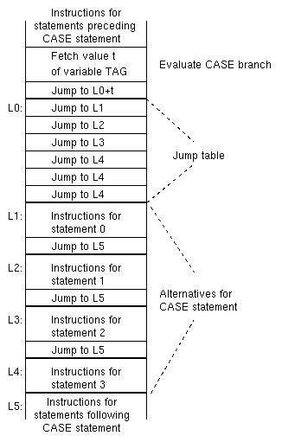
Implementation of case

